Slide 1
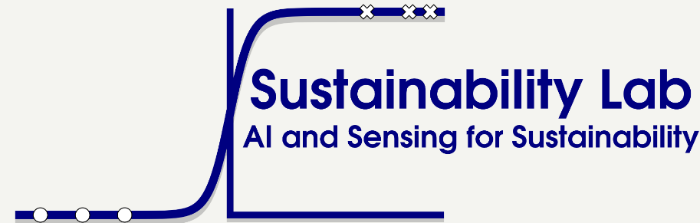

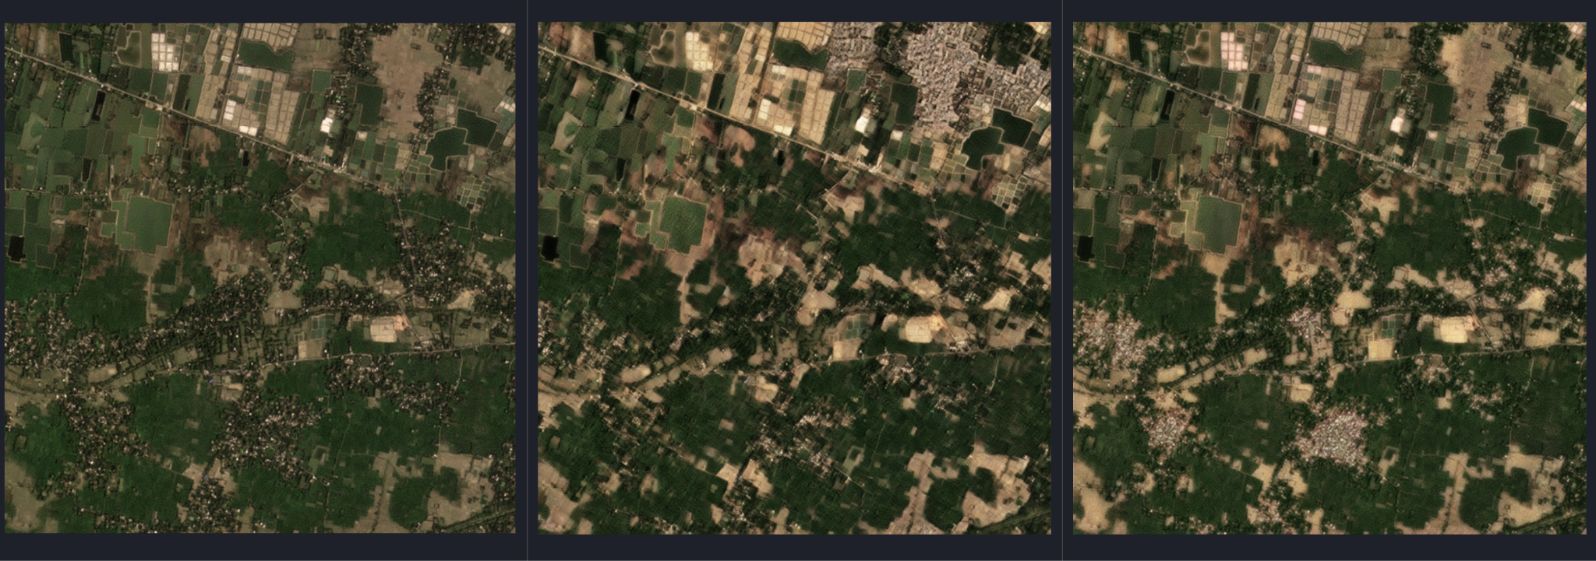
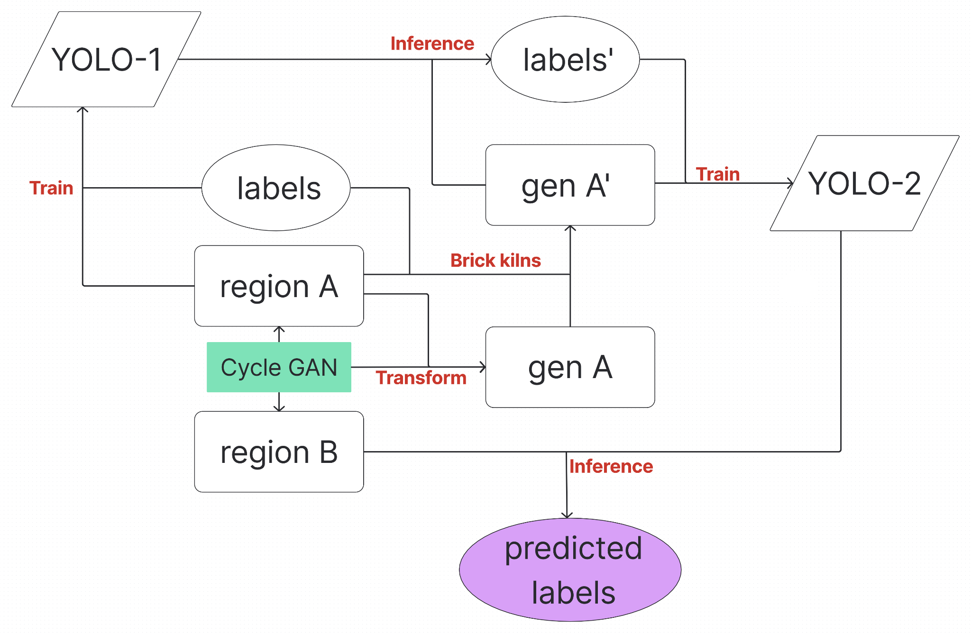
Domain Adaptation
Sustainability Lab
IIT Gandhinagar
Introduction
Generated images
Results
Brick kilns are a significant environmental and social concern in India.
They consume fertile topsoil and release harmful pollutants into the atmosphere.
In regions like Delhi, brick kilns contribute up to 8% of total air pollution.
These sites are often linked to forced labor and unsafe working conditions.
Effective tracking and monitoring of brick kilns is essential to ensure regulatory compliance and promote sustainable practices.
Original
Cycle GAN
CUT
Model | Class-agnostic AP
Delhi_to_WB | 0.506
Delhi(CG)_to_WB | 0.578
Delhi(CUT)_to_WB | 0.535
WB_to_Delhi | 0.605
WB(CG)_to_Delhi | 0.638
WB(CUT)_to_Delhi | 0.654
Training pipeline
Problem Statement
Object detection models like YOLO perform well in identifying brick kilns when trained and tested on images from the same region. However, their performance drops significantly when applied to images from a different region due to variations in landscape, kiln appearance, and environmental conditions. This domain shift poses a major challenge in developing robust, region-independent brick kiln detection systems.
Conclusion
Domain adaptation using image-to-image translation techniques like CycleGAN and CUT significantly improves the generalization of YOLO models for brick kiln detection across different regions. Preserving object-level information while adapting source images to the target domain’s style helps address the domain shift problem effectively.
Proposed Solution
We leverage annotated images from one region to detect brick kilns in a different, unlabeled region. A CycleGAN transforms the source images to match the target region’s style. Brick kilns from the original data are pasted onto these synthetic images to preserve supervision. To correct possible artifacts, an existing detector refines the labels. A new model is then trained on this data to accurately detect brick kilns in the target region.
Future Work
Future work will explore diffusion-based models to improve the quality and diversity of image-to-image translation. Focus will also shift toward domain generalization, using Domain-Adversarial Networks (DANs) to enable robust performance on unseen regions without access to target data.

Slide 2
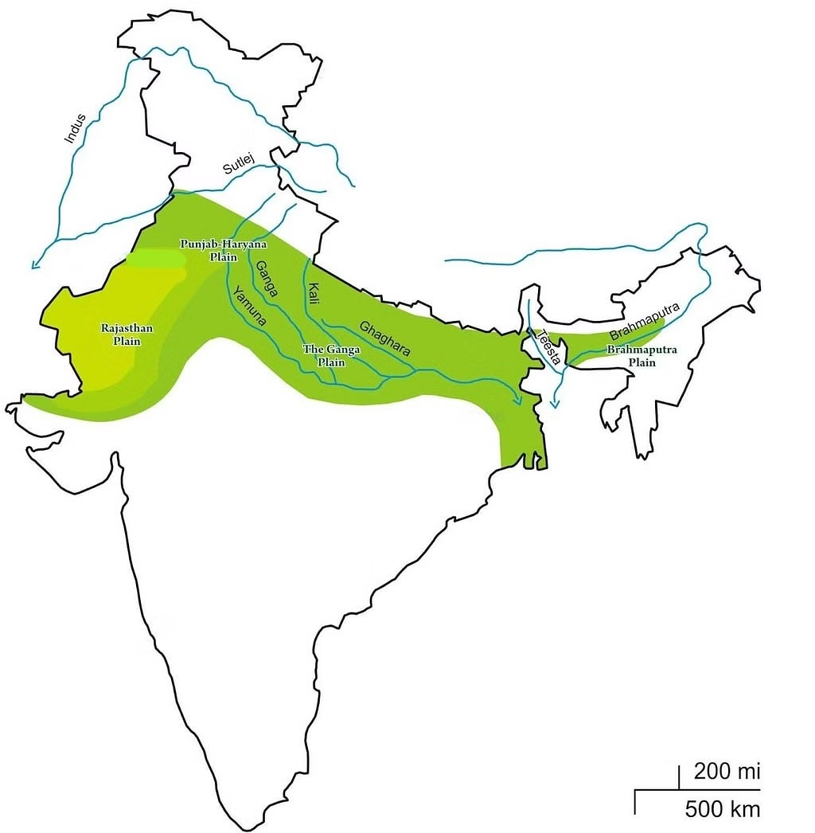
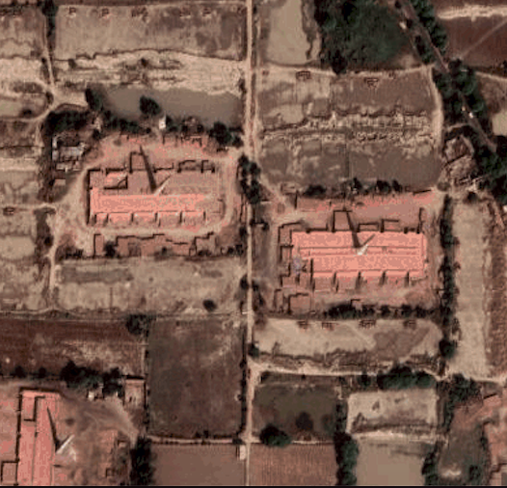
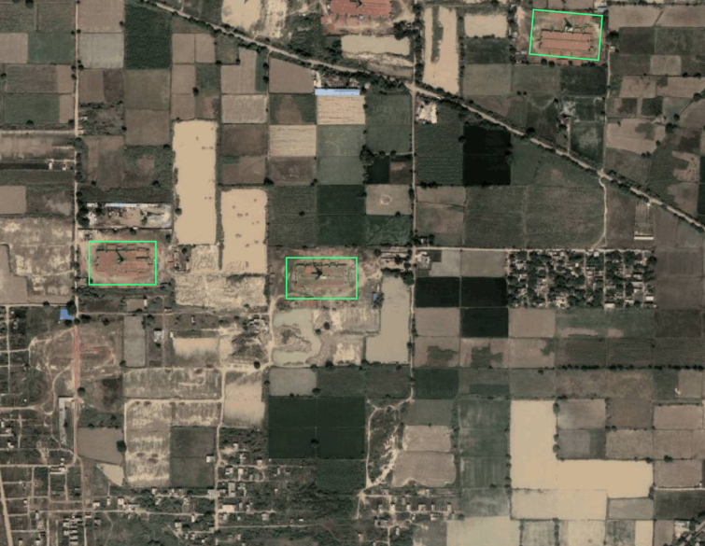

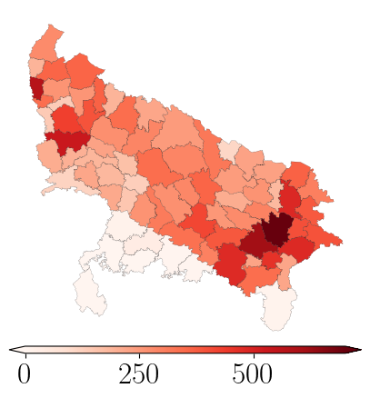
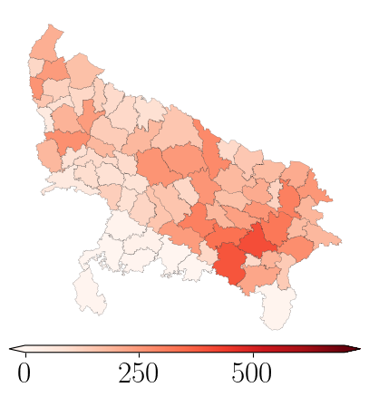
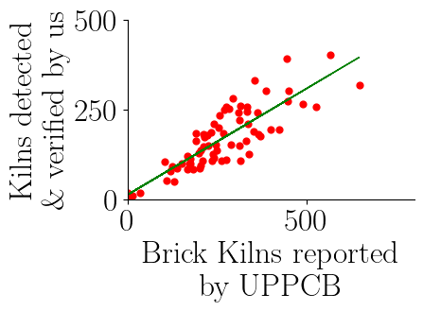
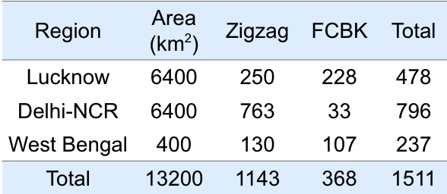
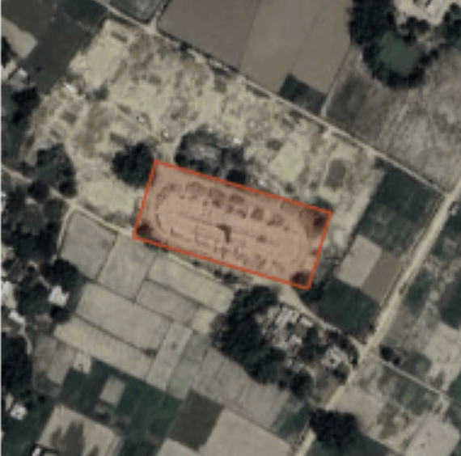
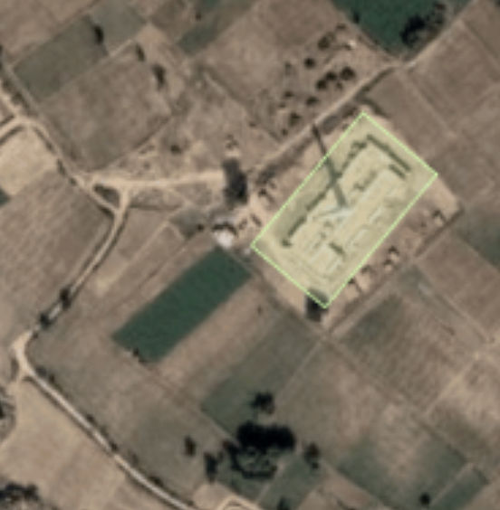
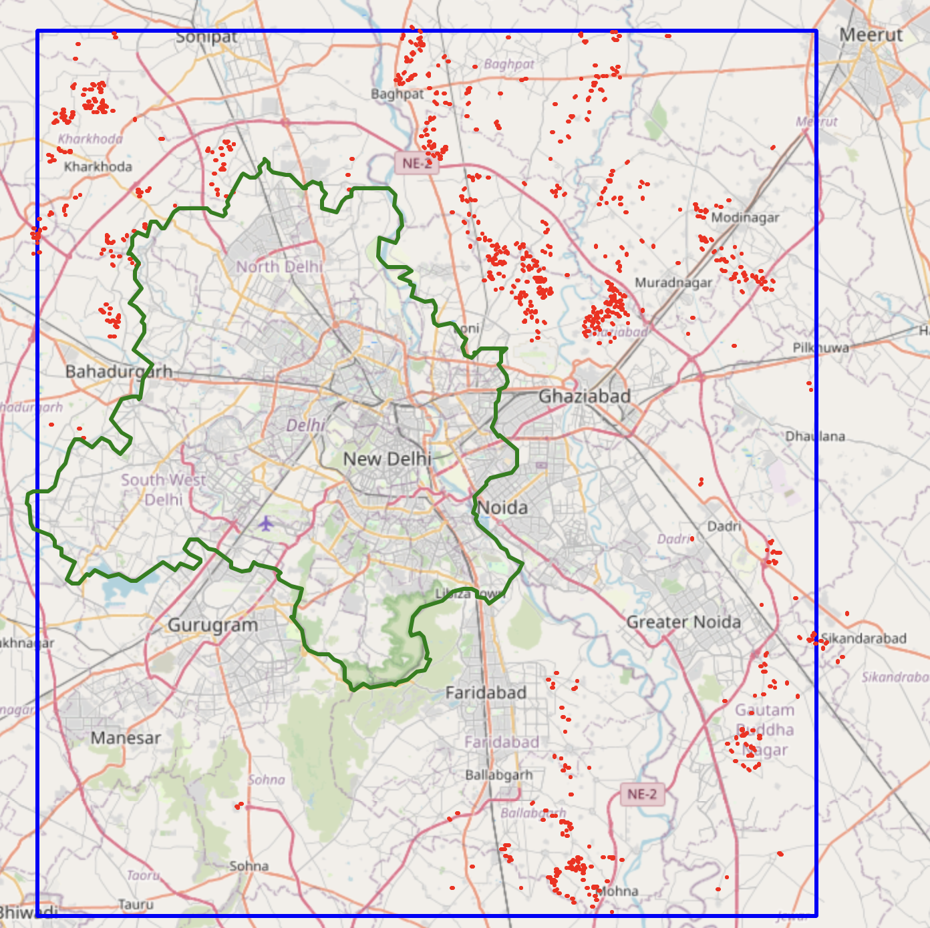
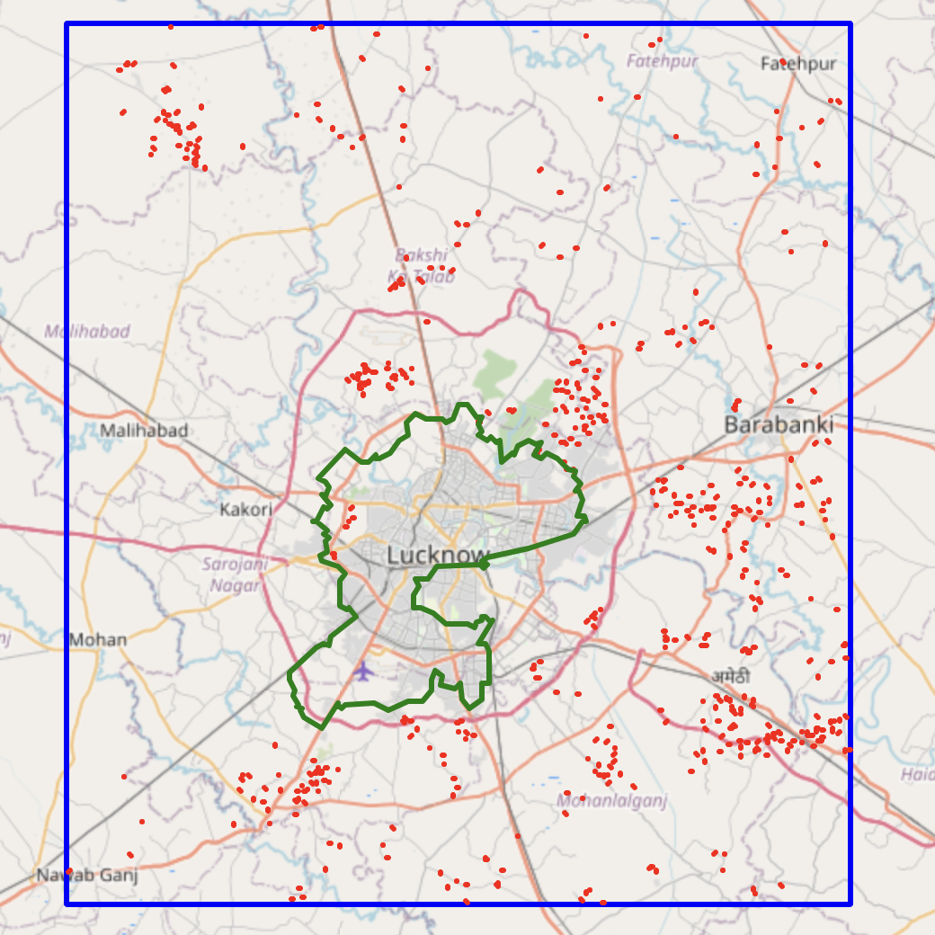
Ember-Sat : A Scalable Approach for Detecting Air Pollution
Sources and Monitoring Compliance Using Satellite Imagery
Rishabh Mondal
IIT Gandhinagar
Introduction
Air pollution kills 7 million people annually.
Brick kilns contribute to 8-14% of air pollution in India.
Brick kilns often violate government policy and their unorganized nature makes large-scale monitoring challenging.
Method
Result
Object detection with ML.
Number of Brick Kilns detected per State
State | Zigzag | FCBK
Uttar Pradesh | 5394 | 6593
Bihar | 3765 | 630
West Bengal | 1802 | 611
Haryana | 2130 | 91
Punjab | 1773 | 234
Total | 14864 | 8159
Trained Model
Satellite Image
Yolov8x-
obb
Detected Kilns
Objective
Geolocation and Classify brick kilns types.
Automatic Compliance Monitoring.
Track brick kiln industry growth.
Training Set
Updating
Hand Validation
Dataset
Major types of brick kilns: Zigzag and Fixed Chimney Bull’s Trench Kiln (FCBK)
NCR - Delhi Region Lucknow Region
Performance of YOLOv8x-obb mAP₅₀
Train Data | Test Data
Lucknow | Lucknow
Lucknow | West Bengal
Lucknow | Delhi-NCR
FCBK | ZIGZAG
0.94 | 0.92
0.61 | 0.68
0.59 | 0.85
Our predictions of brick kilns in Uttar Pradesh correlate 0.87 with UPPCB 2022 survey data.
Problems and Proposed Future Steps
Labeling Problem: Brick kiln labeling is time-consuming and costly. We plan to use Active Learning to overcome this issue.
Domain Adaptation: Training on one state and testing on another reduces performance due to pixel density changes. Self-Supervised Learning can help.
Sample of detected Brick Kilns (a) FCBK (B) Zigzag
References
Reis et al. Real-time flying object detection with yolov8, 2024.

Slide 3
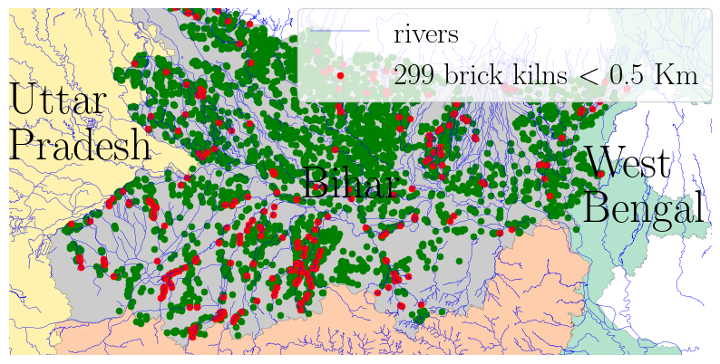
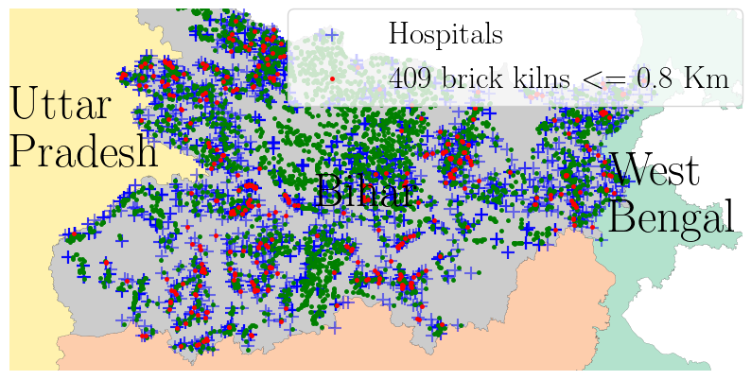
Eye in the Sky: Detection and Compliance Monitoring of
Brick Kilns using Satellite Imagery
Rishabh Mondal, Shataxi Dubey, Vannsh Jani, Shrimay Shah, Suraj Jaiswal, Zeel B Patel, Nipun Batra
IIT Gandhinagar
Introduction
Air pollution kills 7 million people annually.
Brick kilns contribute to 8-14% of air pollution in the Indo-Gangetic plain.
Brick kilns often violate government regulations leading to environmental degradation.
The unorganized nature of brick kilns makes large-scale monitoring challenging.
Method
Results
23023 brick kilns detected & hand-validated from 5 states in the Indo-Gangetic Plain.
We estimate PM_{2.5} emissions from brick kilns to be 1428 to 2856 tons per day.
The range will reduce by 16% and 86% if all FCBK Kilns are converted to Zigzag and Hoffmann Kilns respectively.
The correlation of our results with the UPPCB 2019 survey data is 0.87.
Compliance Studies
Proximity to other brick-kilns: 9777 (about 50%) kilns within a km of each other.
Distance from Human Habitats: 31.82 million people in Indo-Gangetic Plain live within 800m of brick kilns.
Vicinity to Rivers: 1,765 (9%) brick kilns are located within 500 meters of rivers.
Proximity to Hospitals: 3,057 (16%) brick kilns are within 800m of hospitals.
270 (1.4%) of brick kilns violate hospital and river norms.
Object detection with ML.
Satellite Image
Trained Model
Detected Kilns
Indo
Gangetic Region
Yolov8
Number of Brick Kilns detected per State
State | Zigzag | FCBK
Uttar Pradesh | 5394 | 6593
Bihar | 3765 | 630
West Bengal | 1802 | 611
Haryana | 2130 | 91
Punjab | 1773 | 234
Total | 14864 | 8159
Objective
Geolocation and Classification of brick kilns.
Automatic Compliance Monitoring
Training Set
Updating
Hand Validation
Initially trained and tested on Lucknow
In-Region Insights using GMS Imagery
Model | mAP₅₀ ↑
 | FCBK | Zigzag
YOLOv8x | 0.91 | 0.88
YOLOv8x-obb | 0.94 | 0.92
Dataset
Major types of brick kilns: Zigzag and Fixed Chimney Bull’s Trench Kiln (FCBK)
FCBK Zigzag
To get out of region performance, we checked model performance on Delhi and West Bengal datasets.
Region | Area (km²) | Zigzag | FCBK | Total
Lucknow | 6400 | 250 | 228 | 478
Delhi-NCR | 6400 | 763 | 33 | 796
West Bengal | 400 | 130 | 107 | 237
Total | 13200 | 1143 | 368 | 1511
Cross-Region insights using GMS Imagery
Yolov8x-obb | mAP₅₀ ↑
 | FCBK | Zigzag
Delhi | 0.59 | 0.85
West Bengal | 0.61 | 0.68
Sentinel-2 provides imagery across time unlike GMS imagery.
GMS has 1 m to pixel ratio while Sentinel has 10 m to pixel ratio.
Brick Kilns in Uttar Pradesh as per UPPCB 2019 and as per our predictions.
Compliance Monitoring in Bihar State
Limitations and Future Work
Combining SSL methods with YOLO to take into account geographic features.
Multi-spectral and low resolution imagery to improve accuracy and scalability.
Active Learning for efficient annotation.
In-Region Insights using Sentinel Imagery
Model | mAP₅₀ ↑
 | FCBK | Zigzag
YOLOv8x | 0.27 | 0.59
YOLOv8x-obb | 0.34 | 0.60
FCBK
Zigzag
Google Maps Static Imagery Size:1120x1120
Notes:
Object detection with ML
Remove time from table
Move diagram above table
Move iitgn logo to right
Hand-validated
Remove sentinel imagery sentence
Darker bounding box
1.Remove Compass Logo
2. Put sustain logo at top
3. Change Font size
4. Align IIT GN logo with title 5. Keep Title color same as sustain lab Logo
6. Change the distance of compliance study with bullet points.
7. MAP values of Yolov8
8. Web app
5% of population affected in region of study. Policy enforcement challeges— Brick kilns violate government regulations leading to environmental degradation
Segregation → classification
Repalce Dataset with tables Replace image with correct format Use Lucknow Keep zigzag & fcbk in one line.
Table 1 of NeurIPs paper
Number of Brick Kilns with table
Extreme class imbalance not needed
Change the logo.
Difference between sentinel and GMS
Change yolo logo keep it same as training set.

Slide 4

Eye in the Sky: Detection and Compliance Monitoring of Brick Kilns using Satellite Imagery
Rishabh Mondal, Shataxi Dubey, Vannsh Jani, Shrimay Shah, Suraj Jaiswal, Zeel B Patel, Nipun Batra
Introduction
Air pollution kills 7 million people annually.
Brick kilns contribute to 8-14% of air pollution in the Indo-Gangetic plain.
Brick kilns often violate government regulations leading to environmental degradation.
The unorganized nature of brick kilns makes large-scale monitoring challenging.
Method
Results
23023 brick kilns detected & hand-validated from 5 states in the Indo-Gangetic Plain.
We estimate PM_{2.5} emissions from brick kilns to be 1428 to 2856 tons per day.
The range will reduce by 16% and 86% if all FCBK Kilns are converted to Zigzag and Hoffmann Kilns respectively.
The correlation of our results with the UPPCB 2019 survey data is 0.87.
Compliance Studies
Proximity to other brick-kilns: 9777 (about 50%) kilns within a km of each other.
Distance from Human Habitats: 31.82 million people in Indo-Gangetic Plain live within 800m of brick kilns.
Vicinity to Rivers: 1,765 (9%) brick kilns are located within 500 meters of rivers.
Proximity to Hospitals: 3,057 (16%) brick kilns are within 800m of hospitals.
270 (1.4%) of brick kilns violate hospital and river norms.
Object detection with ML.
Satellite Image
Trained Model
Detected Kilns
Indo
Gangetic Region
Yolov8
Number of Brick Kilns detected per State
State | Zigzag | FCBK
Uttar Pradesh | 5394 | 6593
Bihar | 3765 | 630
West Bengal | 1802 | 611
Haryana | 2130 | 91
Punjab | 1773 | 234
Total | 14864 | 8159
Objective
Geolocation and Classification of brick kilns.
Automatic Compliance Monitoring
Training Set
Updating
Hand Validation
Initially trained and tested on Lucknow
In-Region Insights using GMS Imagery
Model | mAP₅₀ ↑
 | FCBK | Zigzag
YOLOv8x | 0.91 | 0.88
YOLOv8x-obb | 0.94 | 0.92
Dataset
Major types of brick kilns: Zigzag and Fixed Chimney Bull’s Trench Kiln (FCBK)
FCBK Zigzag
To get out of region performance, we checked model performance on Delhi and West Bengal datasets.
Region | Area (km²) | Zigzag | FCBK | Total
Lucknow | 6400 | 250 | 228 | 478
Delhi-NCR | 6400 | 763 | 33 | 796
West Bengal | 400 | 130 | 107 | 237
Total | 13200 | 1143 | 368 | 1511
Cross-Region insights using GMS Imagery
Yolov8x-obb | mAP₅₀ ↑
 | FCBK | Zigzag
Delhi | 0.59 | 0.85
West Bengal | 0.61 | 0.68
Sentinel-2 provides imagery across time unlike GMS imagery.
GMS has 1 m to pixel ratio while Sentinel has 10 m to pixel ratio.
Brick Kilns in Uttar Pradesh as per UPPCB 2019 and as per our predictions.
Compliance Monitoring in Bihar State
Limitations and Future Work
Combining SSL methods with YOLO to take into account geographic features.
Multi-spectral and low resolution imagery to improve accuracy and scalability.
Active Learning for efficient annotation.
In-Region Insights using Sentinel Imagery
Model | mAP₅₀ ↑
 | FCBK | Zigzag
YOLOv8x | 0.27 | 0.59
YOLOv8x-obb | 0.34 | 0.60
FCBK
Zigzag
Google Maps Static Imagery Size:1120x1120
Notes:
Object detection with ML
Remove time from table
Move diagram above table
Move iitgn logo to right
Hand-validated
Remove sentinel imagery sentence
Darker bounding box
1.Remove Compass Logo
2. Put sustain logo at top
3. Change Font size
4. Align IIT GN logo with title 5. Keep Title color same as sustain lab Logo
6. Change the distance of compliance study with bullet points.
7. MAP values of Yolov8
8. Web app
5% of population affected in region of study. Policy enforcement challeges— Brick kilns violate government regulations leading to environmental degradation
Segregation → classification
Repalce Dataset with tables Replace image with correct format Use Lucknow Keep zigzag & fcbk in one line.
Table 1 of NeurIPs paper
Number of Brick Kilns with table
Extreme class imbalance not needed
Change the logo.
Difference between sentinel and GMS
Change yolo logo keep it same as training set.

Slide 5


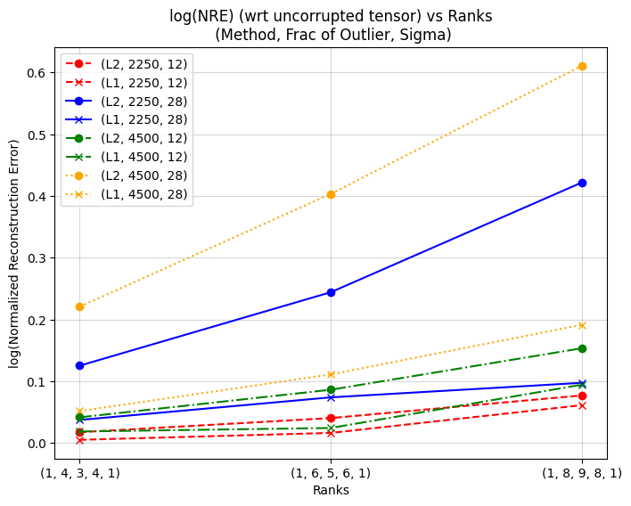
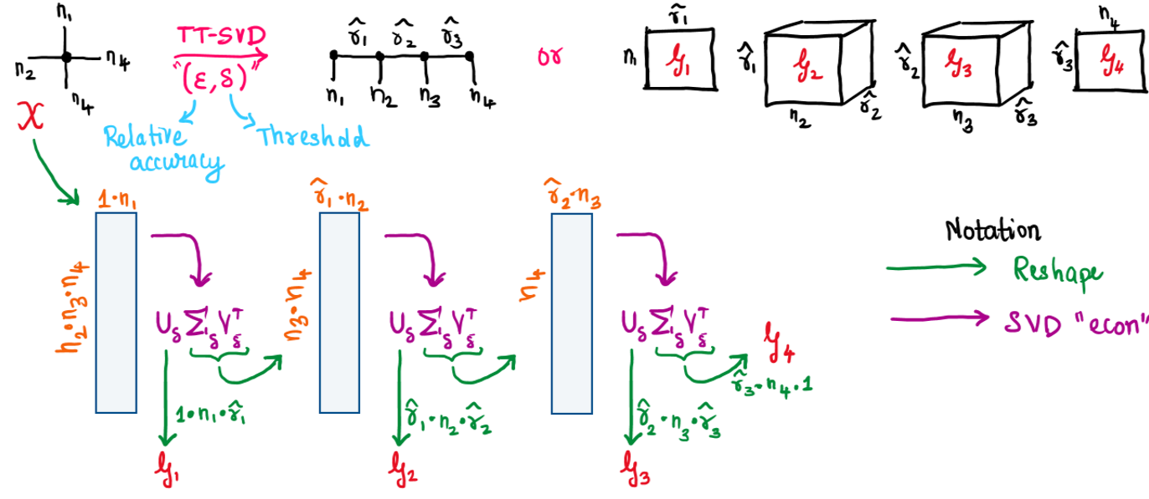
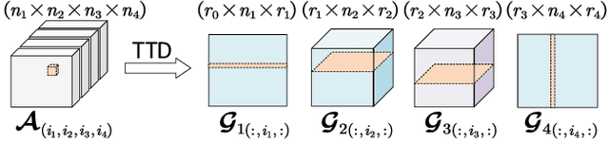
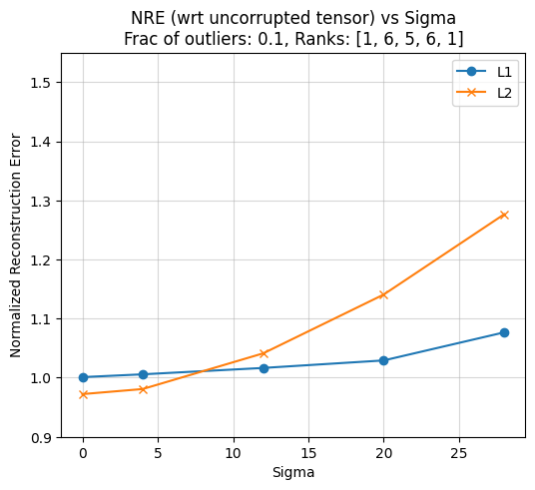
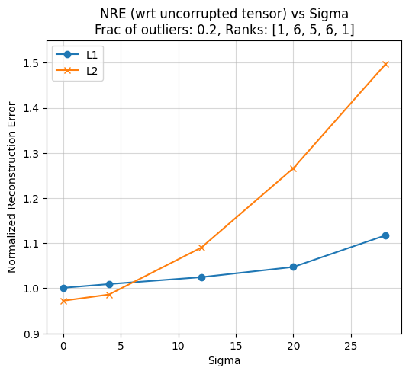
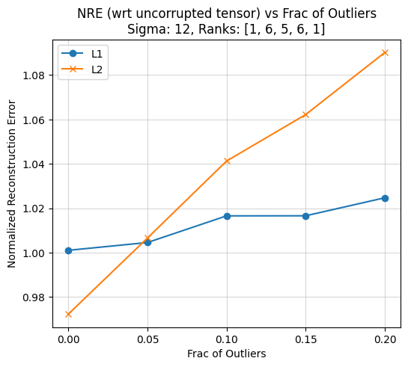
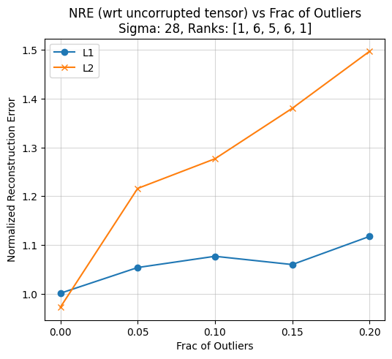
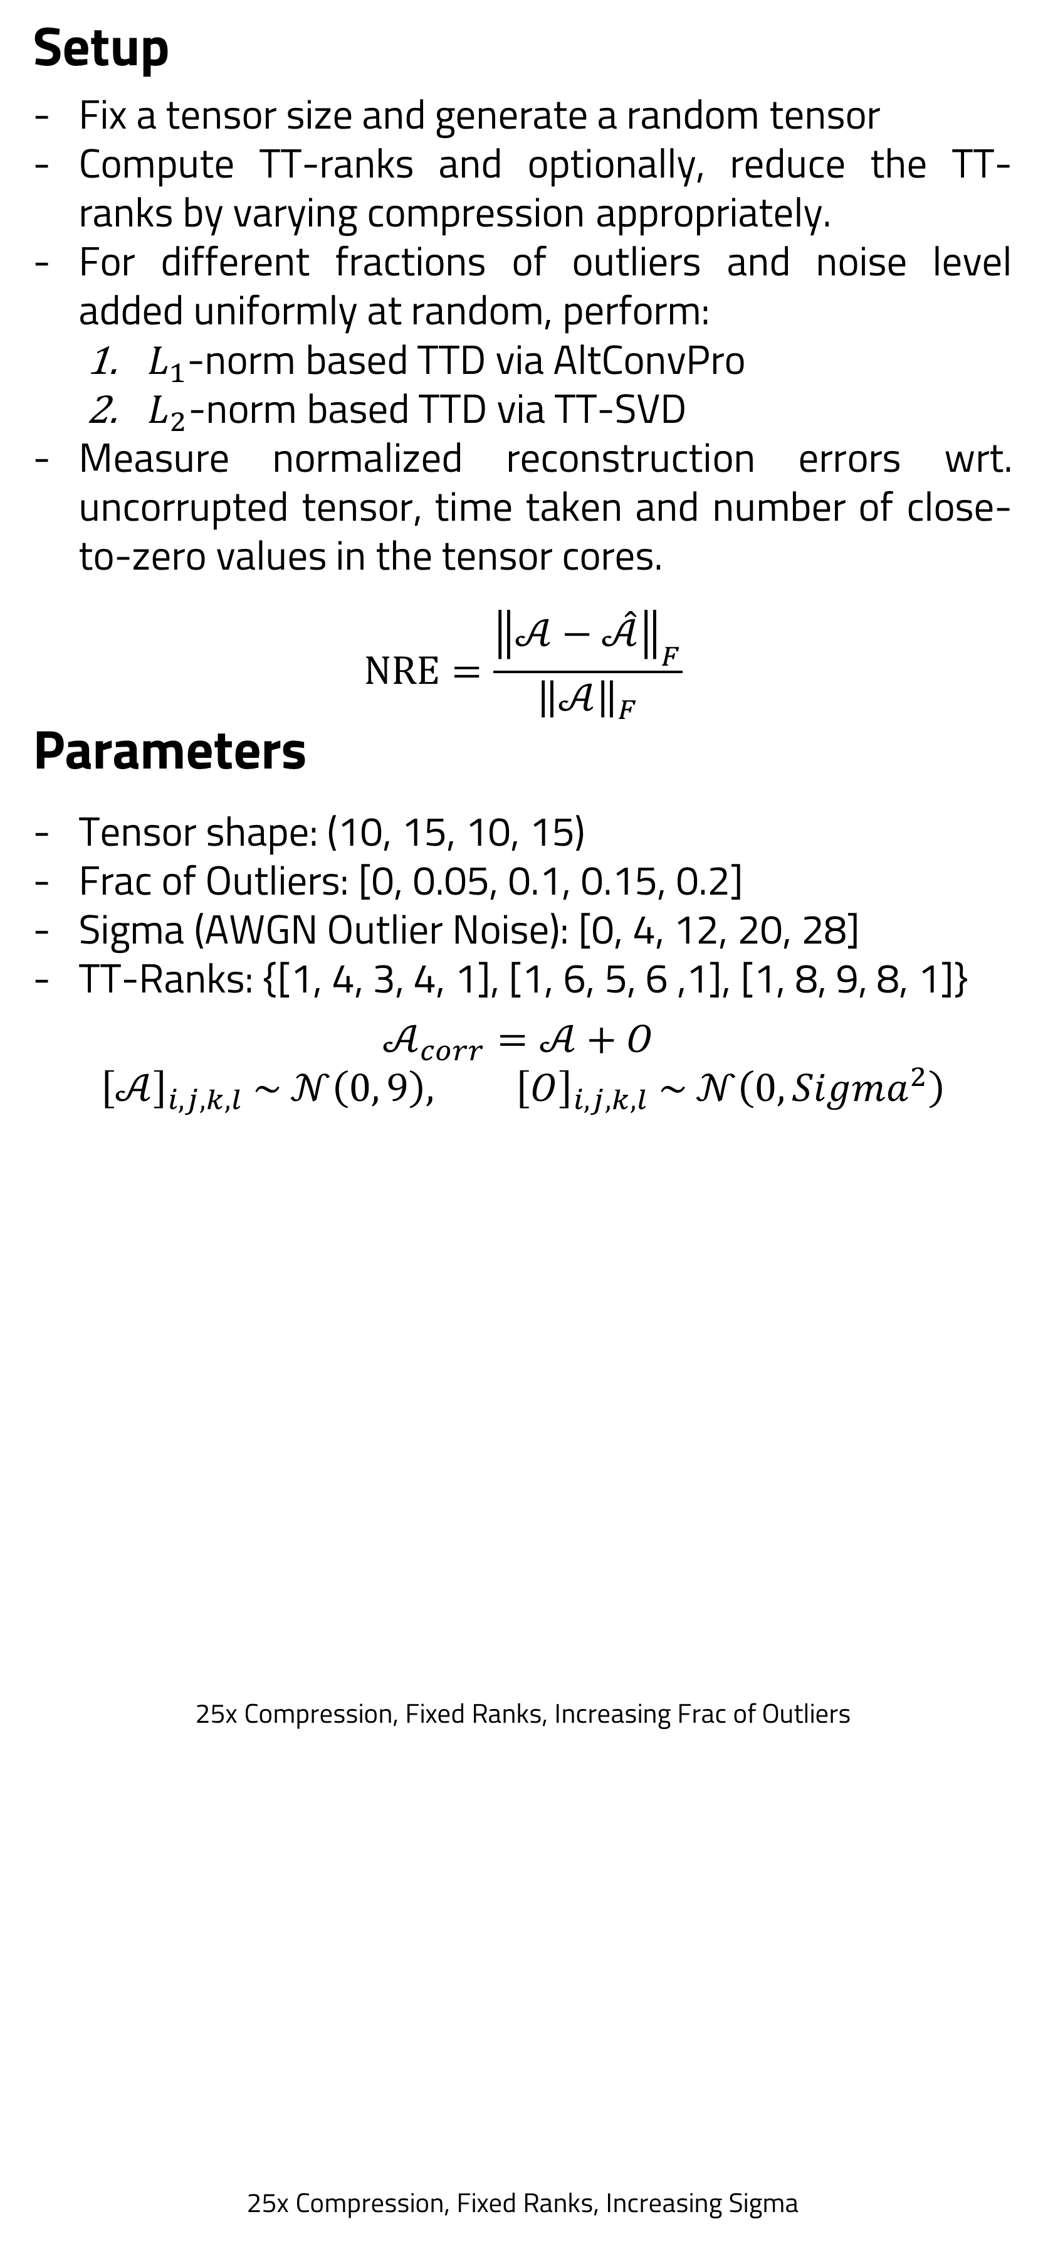
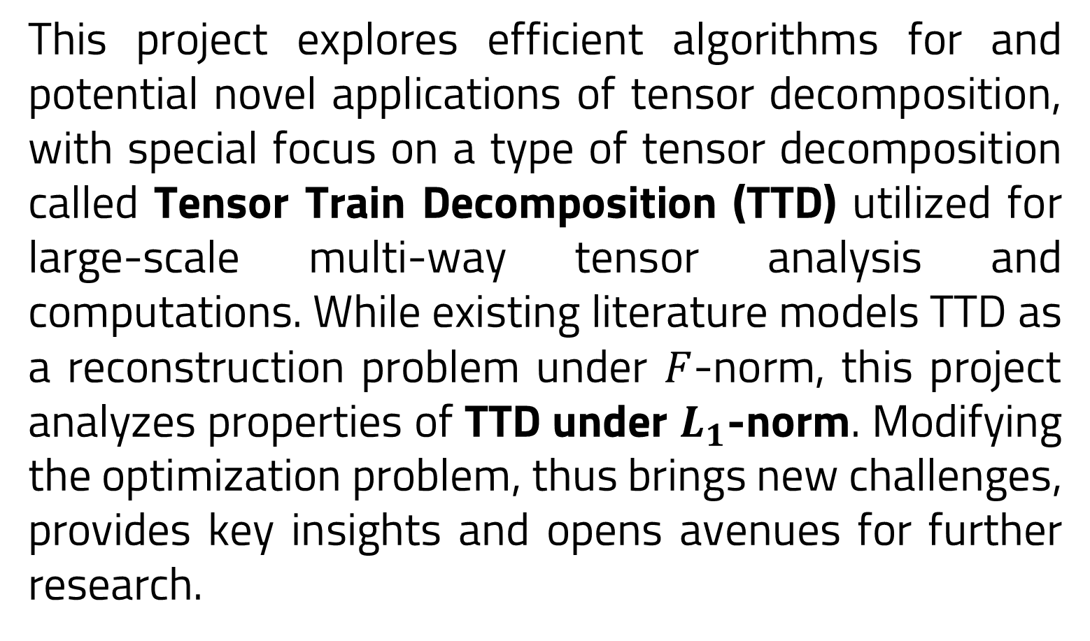
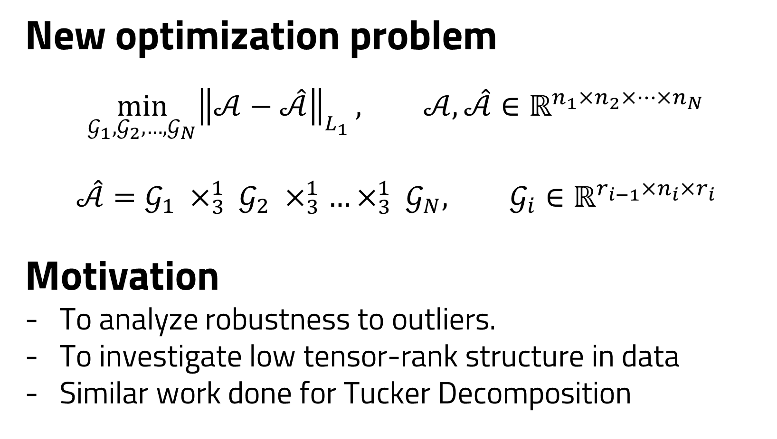
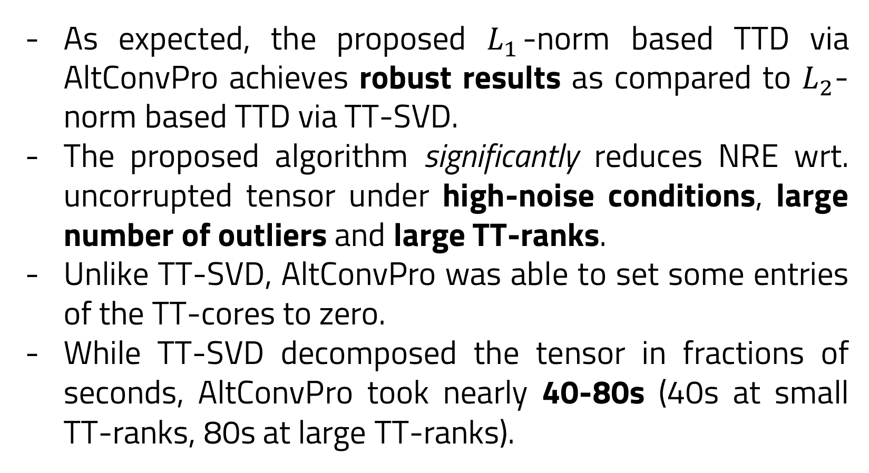
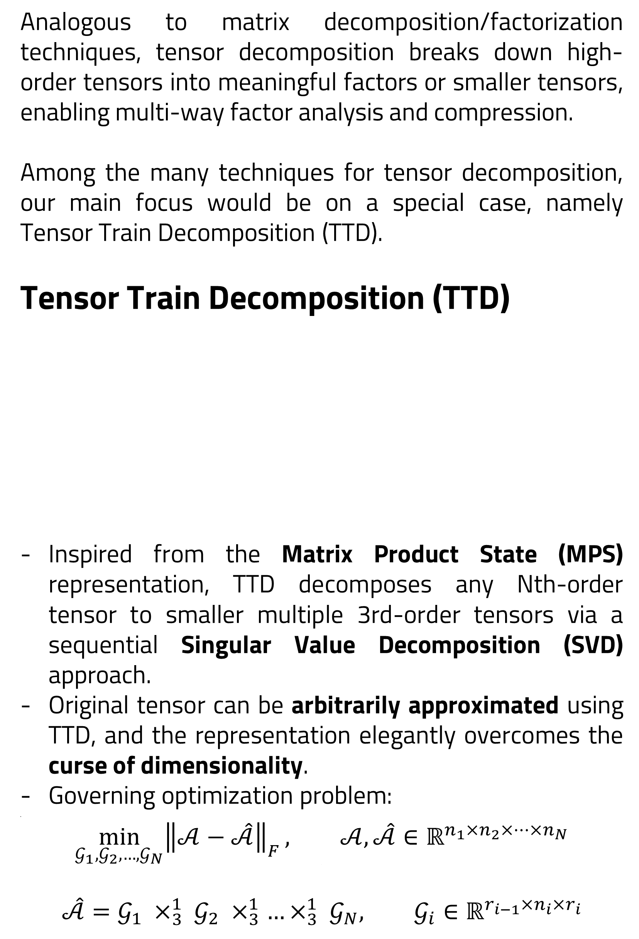
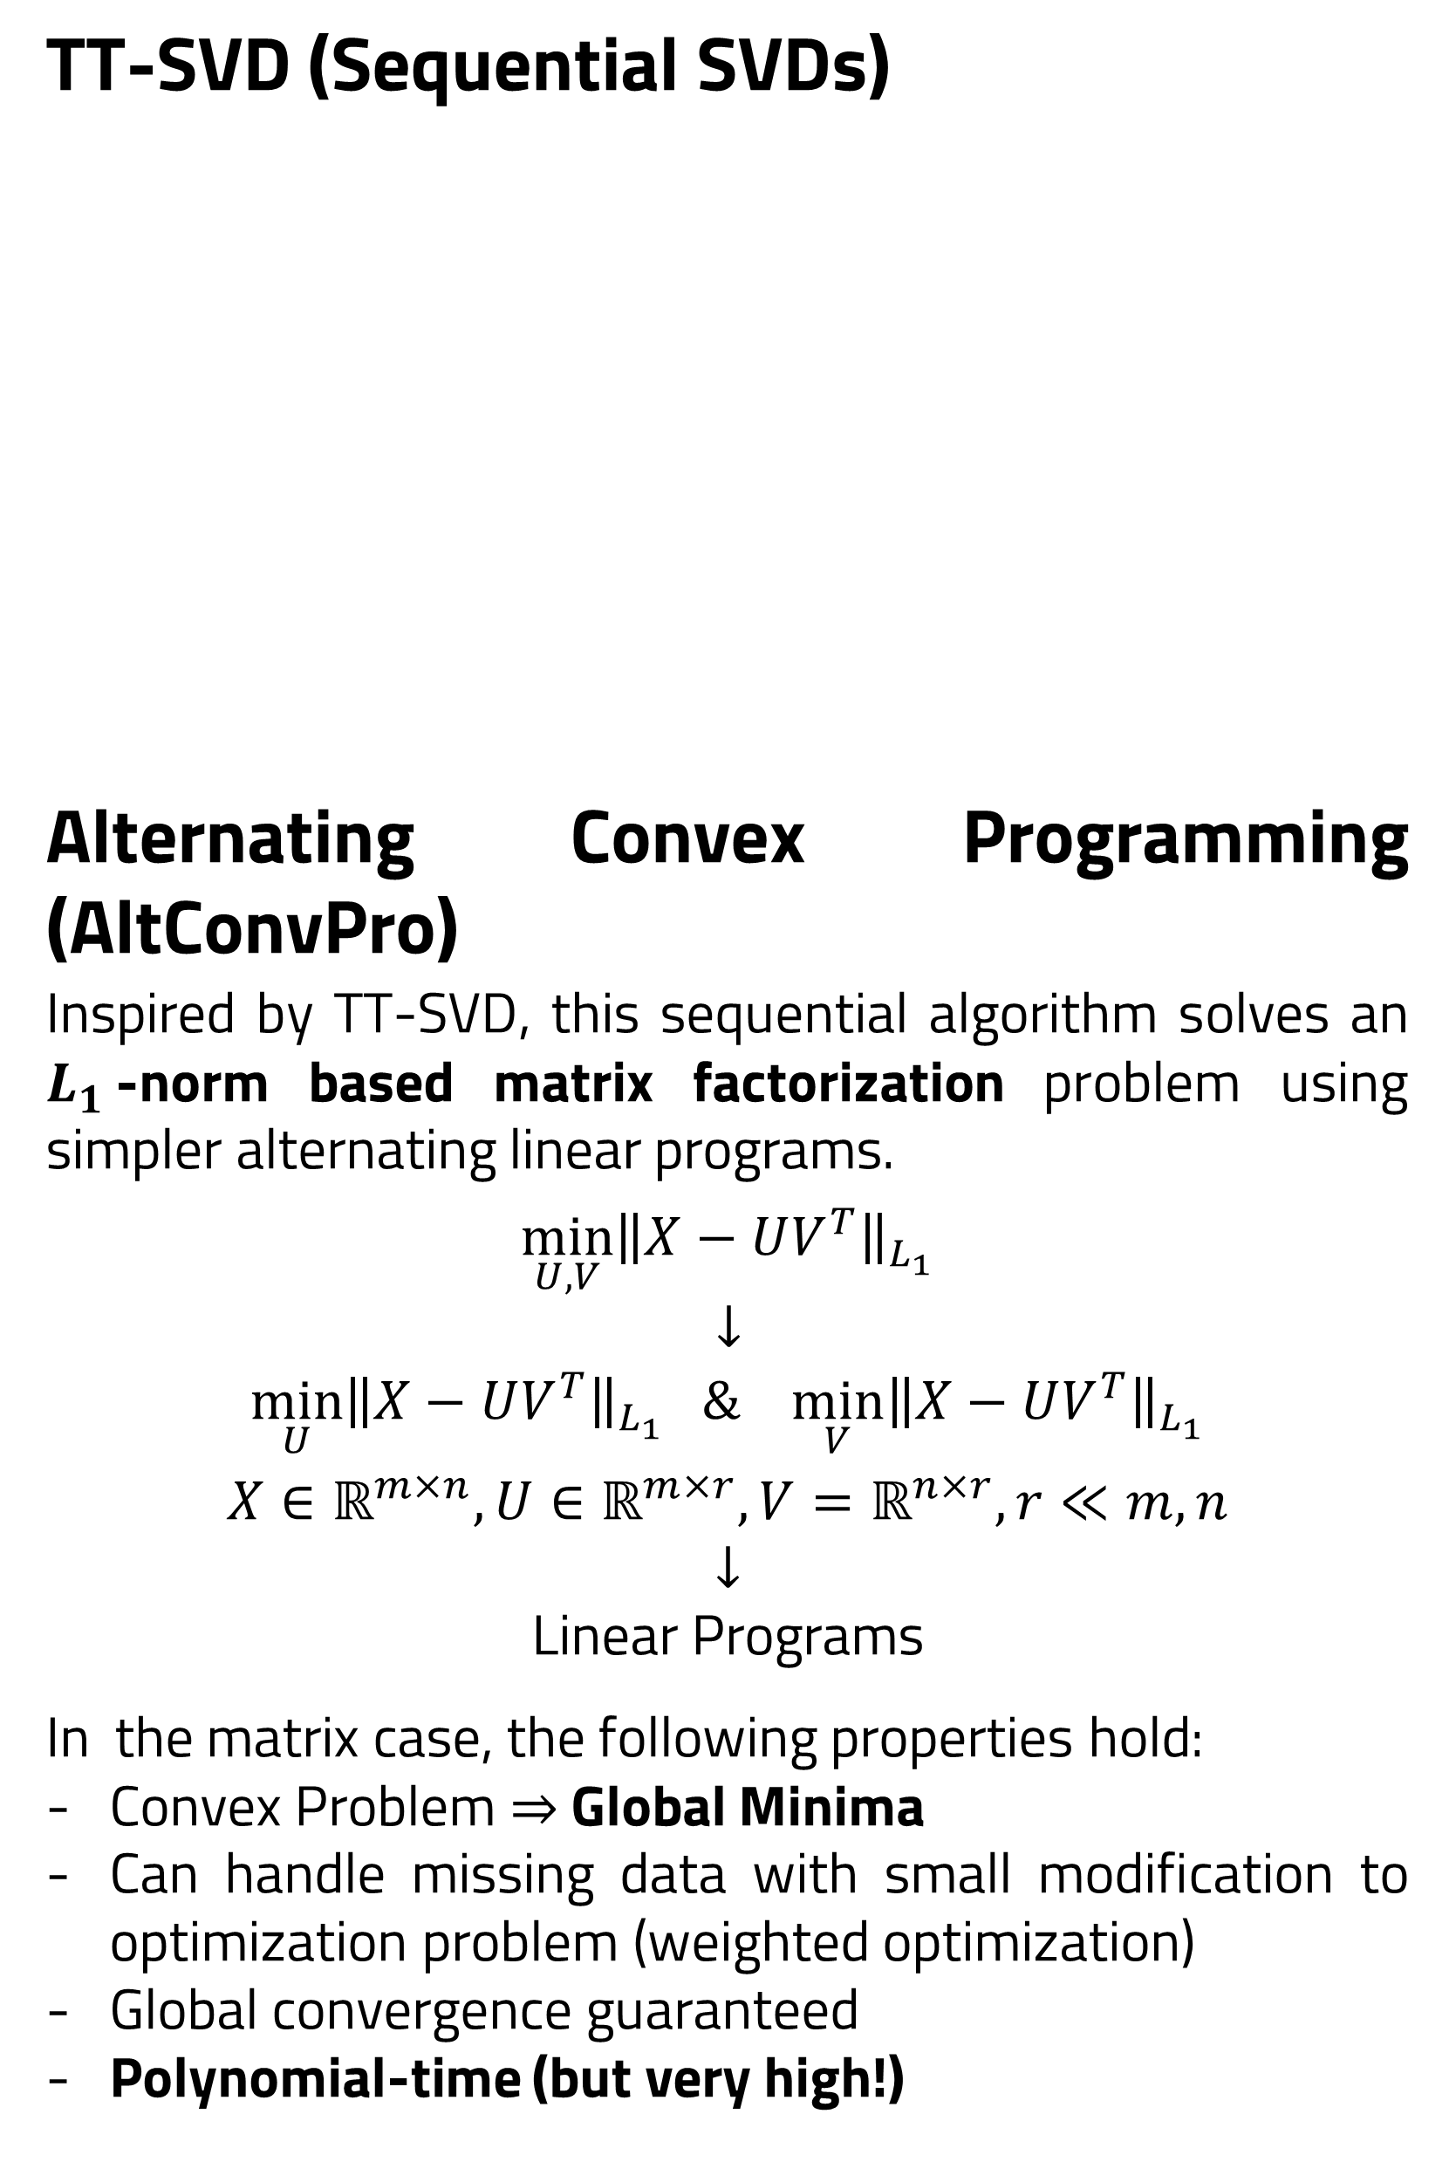
Tensor Decomposition and Applications
Hrriday Viraj Ruparel | Prof. Anirban Dasgupta
Computer Science and Engineering, IIT Gandhinagar
Abstract
Problem Formulation
Experiments
This project explores efficient algorithms for and potential novel applications of tensor decomposition, with special focus on a type of tensor decomposition called Tensor Train Decomposition (TTD) utilized for large-scale multi-way tensor analysis and computations. While existing literature models TTD as a reconstruction problem under $F$-norm, this project analyzes properties of TTD under $L_{1}$-norm. Modifying the optimization problem, thus brings new challenges, provides key insights and opens avenues for further research.
New optimization problem
$$\min_{𝒢_{1}, 𝒢_{2}, …, 𝒢_{N}}{{\left\|𝒜−\hat{𝒜}\right\|}_{L_{1}}}, 𝒜, \hat{𝒜}∈ℝ^{n_{1}×n_{2}×…×n_{N}}$$
.
$$\hat{𝒜}=𝒢_{1} ×_{3}^{1}{ 𝒢}_{2} ×_{3}^{1}…×_{3}^{1}{ 𝒢}_{N}, 𝒢_{i}∈ℝ^{r_{i−1}×n_{i}×r_{i}}$$
Motivation
To analyze robustness to outliers.
To investigate low tensor-rank structure in data
Similar work done for Tucker Decomposition
Setup
Fix a tensor size and generate a random tensor
Compute TT-ranks and optionally, reduce the TT-ranks by varying compression appropriately.
For different fractions of outliers and noise level added uniformly at random, perform:
$L_{1}$-norm based TTD via AltConvPro
$L_{2}$-norm based TTD via TT-SVD
Measure normalized reconstruction errors wrt. uncorrupted tensor, time taken and number of close-to-zero values in the tensor cores.
$$NRE=\frac{{\left\|𝒜−\hat{𝒜}\right\|}_{F}}{{\left\|𝒜\right\|}_{F}}$$
Parameters
Tensor shape: (10, 15, 10, 15)
Frac of Outliers: [0, 0.05, 0.1, 0.15, 0.2]
Sigma (AWGN Outlier Noise): [0, 4, 12, 20, 28]
TT-Ranks: {[1, 4, 3, 4, 1], [1, 6, 5, 6 ,1], [1, 8, 9, 8, 1]}
$$𝒜_{corr}=𝒜+O$$
$${\left[𝒜\right]}_{i, j, k, l} \sim 𝒩\left(0, 9\right), {\left[O\right]}_{i, j, k, l} \sim 𝒩\left(0, Sigma^{2}\right)$$
25x Compression, Fixed Ranks, Increasing Frac of Outliers
25x Compression, Fixed Ranks, Increasing Sigma
Methodology
Variation of log(NRE) with TT-ranks at varying number of outliers and noise levels
Introduction
Observations
Analogous to matrix decomposition/factorization techniques, tensor decomposition breaks down high-order tensors into meaningful factors or smaller tensors, enabling multi-way factor analysis and compression.
Among the many techniques for tensor decomposition, our main focus would be on a special case, namely Tensor Train Decomposition (TTD).
Tensor Train Decomposition (TTD)
Inspired from the Matrix Product State (MPS) representation, TTD decomposes any Nth-order tensor to smaller multiple 3rd-order tensors via a sequential Singular Value Decomposition (SVD) approach.
Original tensor can be arbitrarily approximated using TTD, and the representation elegantly overcomes the curse of dimensionality.
Governing optimization problem:
.
$$\min_{𝒢_{1}, 𝒢_{2}, …, 𝒢_{N}}{{\left\|𝒜−\hat{𝒜}\right\|}_{F}}, 𝒜, \hat{𝒜}∈ℝ^{n_{1}×n_{2}×…×n_{N}}$$
.
$$\hat{𝒜}=𝒢_{1} ×_{3}^{1}{ 𝒢}_{2} ×_{3}^{1}…×_{3}^{1}{ 𝒢}_{N}, 𝒢_{i}∈ℝ^{r_{i−1}×n_{i}×r_{i}}$$
TT-SVD (Sequential SVDs)
Alternating Convex Programming (AltConvPro)
Inspired by TT-SVD, this sequential algorithm solves an $L_{1}$-norm based matrix factorization problem using simpler alternating linear programs.
$$\min_{U, V}{\left\|X−UV^{T}\right\|}_{L_{1}}$$
$↓$
$$\min_{U}{\left\|X−UV^{T}\right\|}_{L_{1}} \& \min_{V}{\left\|X−UV^{T}\right\|}_{L_{1}}$$
$$X∈ℝ^{m×n}, U∈ℝ^{m×r}, V=ℝ^{n×r}, r≪m, n$$
$$↓$$
Linear Programs
In the matrix case, the following properties hold:
Convex Problem $⇒$ Global Minima
Can handle missing data with small modification to optimization problem (weighted optimization)
Global convergence guaranteed
Polynomial-time (but very high!)
As expected, the proposed $L_{1}$-norm based TTD via AltConvPro achieves robust results as compared to $L_{2}$-norm based TTD via TT-SVD.
The proposed algorithm significantly reduces NRE wrt. uncorrupted tensor under high-noise conditions, large number of outliers and large TT-ranks.
Unlike TT-SVD, AltConvPro was able to set some entries of the TT-cores to zero.
While TT-SVD decomposed the tensor in fractions of seconds, AltConvPro took nearly 40-80s (40s at small TT-ranks, 80s at large TT-ranks).
Results
Future Work
Explore probabilistic and other regimes of optimization techniques for tackling both time and space complexity issues
Provide theoretical guarantees about the hardness of the problem
Apply algorithm to real-world applications
References
Le, Duc H., and Panos P. Markopoulos. "Robust Singular Values based on L1-norm PCA." 2022 IEEE Workshop on Signal Processing Systems (SiPS). IEEE, 2022.
Chachlakis, Dimitris G., Ashley Prater-Bennette, and Panos P. Markopoulos. "L1-norm Tucker tensor decomposition." IEEE Access 7 (2019): 178454-178465.
Ke, Qifa, and Takeo Kanade. "Robust L1/norm factorization in the presence of outliers and missing data by alternative convex programming." 2005 IEEE Computer Society Conference on Computer Vision and Pattern Recognition (CVPR'05). Vol. 1. IEEE, 2005.
I would like to thank Prof. Anirban Dasgupta for his unwavering support and guidance throughout the project.

